Slide 1
2015-16 Annual Meeting and Budget Hearing

Slide 2
Annual Meeting Agenda
CALL TO ORDER
PLEDGE OF ALLEGIANCE
ELECTION OF A TEMPORARY CHAIRPERSON
APPOINT RECORDING CLERK
ANNUAL VOLUNTARY SERVICE TO EDUCATION AWARDS
DISTRICT ADMINISTRATOR’S REPORT / STATE OF THE DISTRICT
TREASURER'S REPORT
PRESENTATION OF THE BUDGET
HEARING ON THE BUDGET
RESOLUTION A - ADOPTION OF TAX LEVY
RESOLUTION B - SALARIES FOR BOARD OF EDUCATION MEMBERS
RESOLUTION C – SET DATE AND TIME FOR 2015 ANNUAL MEETING
RESOLUTION D – ACQUISITION OF REAL PROPERTY
RESOLUTION E – LEASING OF PROPERTY
NEW BUSINESS
ADJOURN
Notes:
2

Slide 3
ANNUAL VOLUNTARY SERVICE TO EDUCATION AWARDS
Congratulations and Thank You to:
Erin Friemoth
Notes:
3

Slide 4
Moving Forward toward the
“District of Choice”
Mission Statement:
Ensuring and providing 21st century learning through: engaged student learning, quality teaching, strong leadership, rigorous coursework, and community service opportunities while demonstrating efficiency and effectiveness for the betterment of the students and community.
District Goals
Ensuring a year to a year plus of learning growth for each child, each year
Ensuring programming opportunities through systems and practices that recognize the talents of each child
Ensuring individualized learning by engaging students with a personalized learning environment
Employing the highest quality professional staff
Adapting facilities for current and future educational needs
Demonstrating fiscal responsibility through efficiency and effectiveness

Slide 5
21st Century Learning Committee
VISION STATEMENTS
Time for learning – remove barriers
Competency based education – look at outcomes, not being defined by grade or age
School partnerships with community members/parents/agencies/higher education
Provide meaningful, practical application skills through assignments/projects
High quality instruction – more engagement/interest, meeting the needs of all learners
Utilizing resources, creating self-directed learners
High levels of accountability for students and staff
Creating opportunities through individualized experiences to encourage self directed learning

Slide 6
Six Facets
(Areas of Operational Focus toward fulfilling District Goals and Vision Statements)
Student Achievement
Quality Teaching / Quality Staff and Strong Instructional Leadership
Technology
Facilities
Operations
Community Engagement
*ETCSD is granted permission by Rubik’s Brand Ltd. to utilize the Rubik’s cube image
Dr. Hibner (2011)

Slide 7
Head Count Definition
Includes
resident and non-resident students enrolled within the district
Excludes
resident students enrolled outside the district
Students enrolled in alternative & special education placements
The enrollment numbers in the following charts are as of September of each year, except for the estimate for the current year

Slide 8
Enrollment History
(including estimate for 2015-16)
2014-15 Senior Class: 141
2015-16 Senior Class Projection: 115 2015-16 4K Projection: 91

Slide 9
General Fund Components
(2015-16 School Year)

Slide 10
General Fund & Fund 27 Salaries & Benefits
(2015-16 School Year)

Slide 11
Salary/Benefit Distribution by Staff
(2015-16 School Year)
Basic Salary/Benefits Only – does not include extra duties.

Slide 12
Mill Rate History
(Including 2015-16 estimate)
See Appendix “Rock Valley Athletic Conference 2012-13 Equalized Tax Levy Information” for Comparables

Slide 13
Percent Change in Equalized Value
See Appendix “WI DPI Analysis of General Aid and Equalization Aid Formula Components” for Comparisons to State Increases

Slide 14
Mill Rate can increase, even when taxes decrease
Mill Rate = taxes / property ($1000)
EXAMPLE YEAR 1
School Taxes: $2,000 each
EXAMPLE YEAR 2
School Taxes: $1,944 each
2.8% decrease from previous year
MILL RATE
$2000
$200
=
$10.00
MILL RATE
$1944
$190
=
$10.23
$200K
$200K
$190K
$190K
2014-15
School Taxes: $2,084 each
2015-16 ESTIMATE
School Taxes: $2,039 each
2.14% decrease from previous year
MILL RATE
$2084
$200
=
$10.42
MILL RATE
$2039
$200
=
$10.20
$200K
$200K
$200K
$200K

Slide 15
2014-15 Tax Levy by Municipality
See Appendix “Tax Bill Analysis” for steps to understand the components of a tax bill.

Slide 16
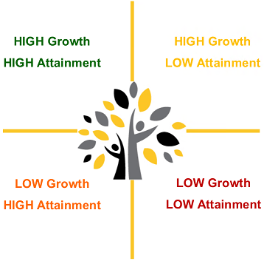
Student Achievement
Learning Growth and Attainment

Slide 17
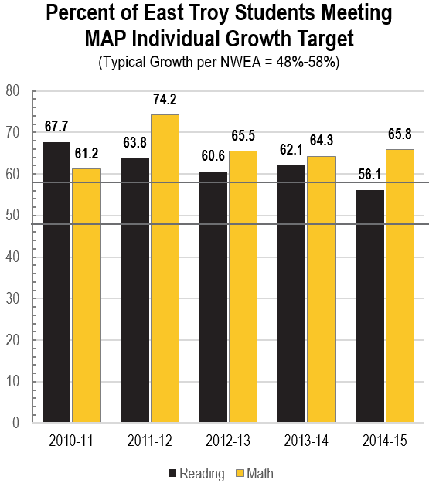
MAP Growth Results
According to NWEA, about 48-58% of students reach their individual growth target. East Troy meets and exceeds typical growth for math and reading for grades 5K through 8.

Slide 18
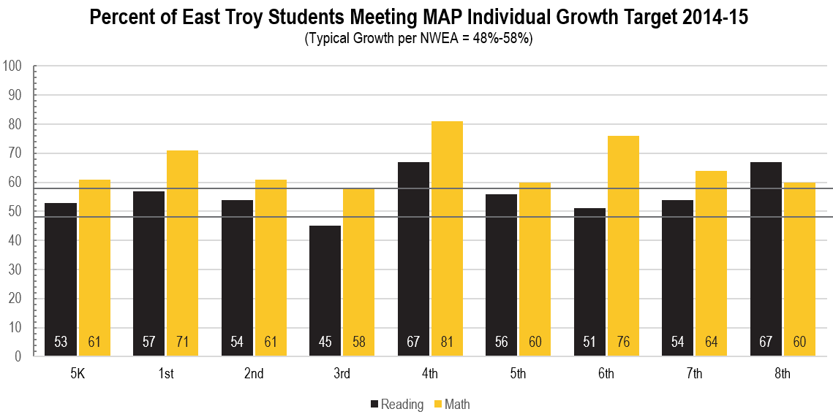
Reading: 7 of 8 cohorts above 50% of students Met Targeted Growth
Math: 7 of 8 cohorts above 50% of students Met Targeted Growth
MAP Growth Results
Reading: 8 of 9 cohorts average above 50% of students Met Targeted Growth
2013-14 (9 of 9), 2012-13 (9 of 9), 2011-12 (7 of 9)
Math: 9 of 9 cohorts average above 50% of students Met Targeted Growth
2013-14 (8 of 9), 2012-13 (8 of 9), 2011-12 (7 of 7)

Slide 19
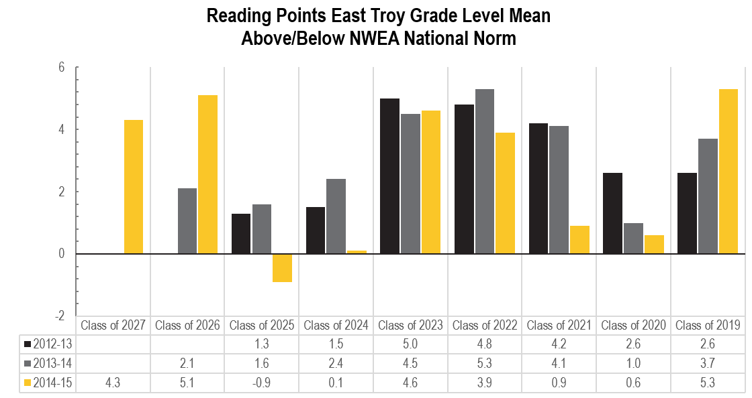
MAP Reading Attainment
8 of 9 cohorts average above National Norm in 2014-15
2013-14 (9 of 9), 2012-13 (9 of 9), 2011-12 (9 of 9)
3 of 8 cohorts overall increase of percentage meeting targeted growth
2013-14 (5 of 8), 2012-13 (3 of 8), 2011-12 (3 of 6)

Slide 20
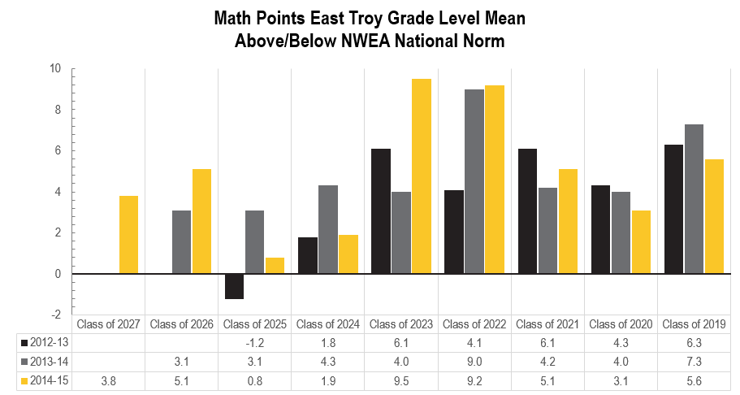
MAP Math Attainment
9 of 9 cohorts average above National Norm in 2014-15
2013-14 (9 of 9), 2012-13 (8 of 9), 2011-12 (7 of 7)
4 of 8 cohorts overall increase of percentage meeting targeted growth
2013-14 (3 of 8), 2012-13 (0 of 6), 2011-12 (5 of 6)

Slide 21
Badger 3-8 Math and Reading
The 2014-15 Badger Exam summary results are embargoed until October 2015.

Slide 22
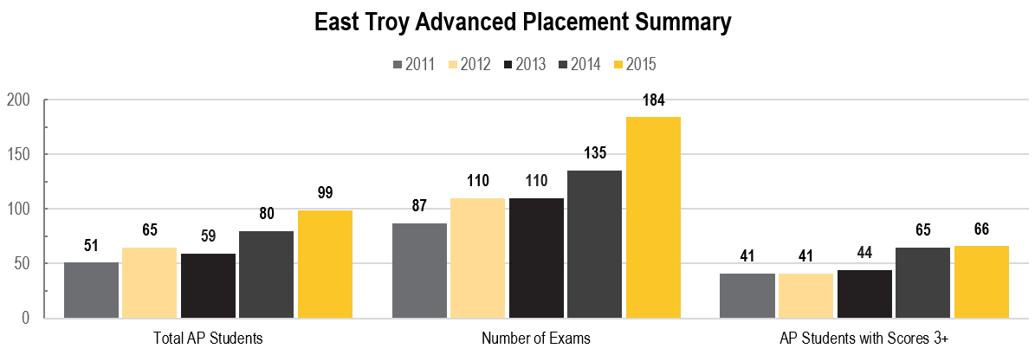
Advanced Placement (AP)

Slide 23
EPAS (ACT) Exams
Gr. | Prior to 2014-15 |  |  |  | Beginning in 2014-15
 | Explore | Plan | Aspire | ACT | Explore | Plan | Aspire | ACT
8 | District Elective |  |  | Student Elective |  |  |  | Student Elective
9 | District Elective |  |  | Student Elective |  |  | WI Mandate | Student Elective
10 |  | District Elective |  | Student Elective |  |  | WI Mandate | Student Elective
11 |  |  |  | Student Elective |  |  |  | WI Mandate AND Student Elective
Beginning in 2014-15, all 9th and 10th grade students were required to take the Aspire (the replacement of the Explore and Plan)
Beginning in 2014-15, all 11th grade students were required to take the ACT. Students may also elect to take the exam at any time.

Slide 24
Grad Year | Reading | English | Math | Science | Composite | Participation Rate
2008 | 22.6 | 21.4 | 21.5 | 22.1 | 22.0 | 55.6
2009 | 22.4 | 20.8 | 21.4 | 22.1 | 21.9 | 61.2
2010 | 22.8 | 21.9 | 21.9 | 22.5 | 22.4 | 65.1
2011 | 22.7 | 21.1 | 21.8 | 22.4 | 22.2 | 62.3
2012 | 22.5 | 21.4 | 21.0 | 22.6 | 22.1 | 70.6
2013 | 22.7 | 21.6 | 22.2 | 23.3 | 22.6 | 74.6
2014 | 22.6 | 22.4 | 22.4 | 22.9 | 22.7 | 60.5
2015* | 23.9 | 22.9 | 22.7 | 22.9 | 23.1
Elective ACT Results East Troy Scores and Participation Rate
State Avg Composite
22.2
22.1
22.1
22.2
22.2
Participation Rate: | 62.3 | 70.6 | 74.6 | 60.5 | 70.0
*2014-15 data is an estimate. Data will be certified Spring 2016.

Slide 25
Elective ACT Results: District Comparison
 | District | 2010-11 |  | 2011-12 |  | 2012-13 |  | 2013-14 |  | 2014-15
 |  | Score | % | Score | % | Score | % | Score | % | Score | %
Surrounding Districts | Burlington | 22.4 | 56.8 | 22.3 | 58.1 | 22.3 | 58.2 | 22.3 | 54.3
 | Elkhorn | 21.8 | 59.6 | 20.9 | 62.6 | 22.1 | 66.7 | 21.8 | 60.8
 | Mukwonago | 23.4 | 66.7 | 23.3 | 69.2 | 23.6 | 73.0 | 23.7 | 73.8
 | Whitewater | 21.7 | 63.8 | 21.7 | 63.6 | 22.7 | 47.8 | 23.8 | 45.8
 | East Troy | 22.2 | 62.3 | 22.1 | 70.6 | 22.6 | 74.6 | 22.7 | 60.5 | 23.1 | 70.0
Other Local Districts | Arrowhead | 24.8 | 81.7 | 25.0 | 83.2 | 24.6 | 82.0 | 24.8 | 83.1
 | Elmbrook | 25.2 | 85.5 | 25.4 | 84.5 | 24.9 | 87.4 | 25.0 | 83.5
 | Kettle Moraine | 23.9 | 81.0 | 24.1 | 80.3 | 23.8 | 82.8 | 23.8 | 84.5
 | Mequon-Thiensville | 25.7 | 82.4 | 25.2 | 79.7 | 25.0 | 85.9 | 26.0 | 87.5
 | Waterford | 22.9 | 71.1 | 22.6 | 68.7 | 23.1 | 79.1 | 22.9 | 68.9
 | Waukesha | 22.9 | 56.3 | 22.5 | 57.1 | 22.7 | 54.5 | 22.4 | 57.8
Score = Average Composite ACT Score | % = Participation Rate
*2014-15 data is not yet available. Data will be certified Spring 2016.

Slide 26
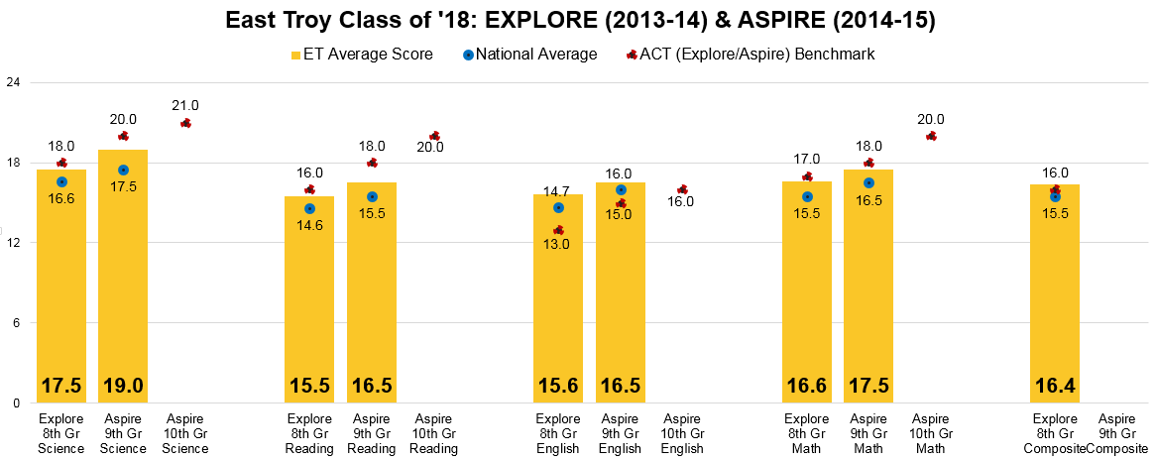
EPAS Results (Explore, Aspire, ACT)
Class of 2018 Cohort (2015-16 Grade 10)
432
430
432
425
428
428
428
424
428
421
426
424
427
423
429
426
427
*The Aspire scores noted in the graph are estimates per an Aspire concordance table; Exam score scale begins at 400. Actual Aspire scores are noted in green.
East Troy Goal Growth (2.5-3 growth points a year) & Actual Growth
 | Reading |  | English |  | Math |  | Science |  | Composite
8th to 9th Explore | 18.0-18.5 | 1.0 | 18.1-18.6 | 0.9 | 19.1-19.6 | 0.9 | 20.0-20.5 | 1.5 | 18.9-19.4
9th to 10th Aspire | 20.5-21.5 |  | 20.6-21.6 |  | 21.6-22.6 |  | 22.5-23.5 |  | 21.4-22.4
10th to 11th ACT | 23.0-24.5 |  | 23.1-24.6 |  | 24.1-25.6 |  | 25.0-26.5 |  | 23.9-25.4
10th to 11th ACT (Aspire Goal) | 21.4 |  | 19.8 |  | 21.1 |  | 21.8 |  | 21.3
*Students who score at or above these benchmarks are on target to meet ACT’s College and Career Readiness Benchmarks when they leave HS
**East Troy goal score based on 2.5-3.0 points of growth per year.

Slide 27
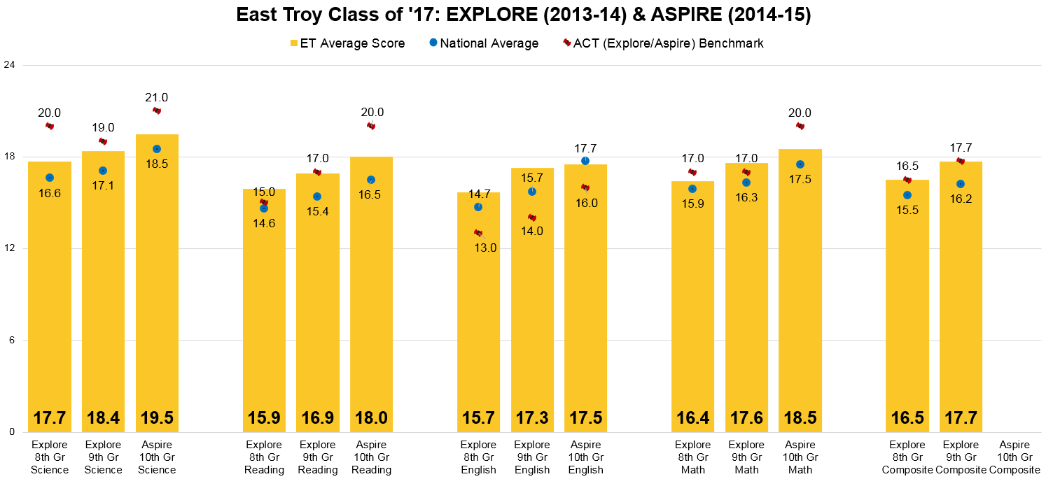
EPAS Results (Explore, Aspire, ACT)
Class of 2017 Cohort (2015-16 Grade 11)
432
428
429
431
426
427
423
428
429
425
431
429
429
*The Aspire scores noted in the graph are estimates per an Aspire concordance table; Exam score scale begins at 400. Actual Aspire scores are noted in green.
East Troy Goal Growth (2.5-3 growth points a year) & Actual Growth
 | Reading |  | English |  | Math |  | Science |  | Composite
8th to 9th Explore | 18.4-18.9 | 1.0 | 18.2-18.7 | 1.6 | 18.9-19.4 | 1.2 | 20.2-20.7 | 0.7 | 19-19.5 | 1.2
9th to 10th Aspire | 20.9-21.9 | 1.1 | 20.7-21.7 | 0.2 | 21.4-22.4 | 0.9 | 22.7-21.7 | 1.1 | 21.5-22.5
10th to 11th ACT | 23.4-24.9 |  | 23.2-24.7 |  | 23.9-25.4 |  | 25.2-26.7 |  | 24-25.5
10th to 11th ACT (Aspire Goal) | 21.7 |  | 20.1 |  | 20.8 |  | 22.1 |  | 21.6

Slide 28
EPAS Results (Explore, Plan, ACT)
Class of 2016 Cohort (2015-16 Grade 12)
East Troy Goal Growth (2.5-3 growth points a year) & Actual Growth
 | Science |  | Reading |  | English |  | Math |  | Composite
8th to 9th Explore | 19.3-19.8 | 1.6 | 16.9-17.4 | 1.8 | 17.5-18.0 | 1.7 | 18.8-19.3 | 1.1 | 18.2-18.7 | 1.6
9th to 10th Plan | 21.8-22.8 | 1.5 | 19.4-20.4 | 1.8 | 20.0-21.0 | 1.3 | 21.3-22.3 | 2.1 | 20.7-21.7 | 1.7
10th to 11th ACT | 24.3-25.8 | 1.0 | 21.9-23.4 | 1.9 | 22.5-24.0 | 1.3 | 23.8-25.3 | 1.4 | 23.2-24.7 | 1.4
*ACT 11th Grade = 100% Participation (Per State Mandate)

Slide 29
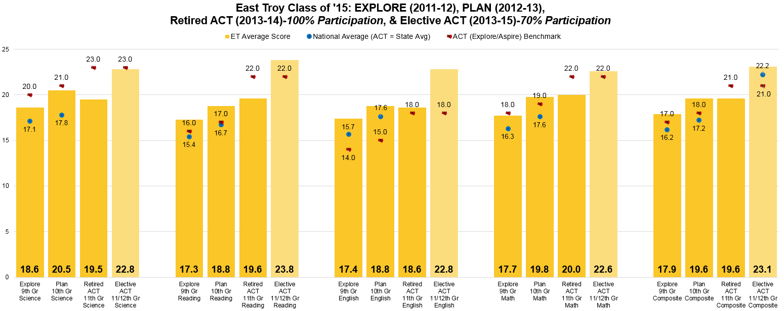
EPAS Results (Explore, Plan, ACT)
Class of 2015 Cohort (2015 Graduates)
East Troy Goal Growth (2.5-3 growth points a year) & Actual Growth
 | Science |  | Reading |  | English |  | Math |  | Composite
9th to 10th Plan | 21.1-21.6 | 1.9 | 19.8-20.3 | 1.5 | 19.9-20.4 | 1.4 | 20.2-20.7 | 2.1 | 20.4-20.9 | 1.7
10th to 11th Retired ACT | 23.6-24.6 | -1.0 | 22.3-23.3 | 0.8 | 22.4-23.4 | -0.2 | 22.7-23.7 | 0.2 | 22.9-23.9 | 0.0
10th to 11th Elective ACT |  | 2.3 |  | 5.0 |  | 4.0 |  | 2.8 |  | 3.5
Retired ACT = 100% Participation Elective ACT = 70% Participation

Slide 30
EPAS Results (Explore, Plan, Aspire, ACT)
Cohort – Percent Met or Exceeded Benchmark (“Proficient”)
Class of 2018 2015-16 Grade 10 | Reading |  | English |  | Math |  | Science |  | Composite
 | ET | Nat | ET | Nat | ET | Nat | ET | Nat | ET | Nat
8th Gr Explore (2013-14) | 46% | 36% | 71% | 68% | 47% | 36% | 50 | 37%
9th Gr Aspire (2014-15) | 42% | 38% | 66% | 60% | 39% | 35% | 43% | 30%
10th Gr Aspire (2015-16)
Class of 2017 2015-16 Grade 11 | Reading |  | English |  | Math |  | Science |  | Composite
 | ET | Nat | ET | Nat | ET | Nat | ET | Nat | ET | Nat
8th Gr Explore (2012-13) | 52% | 46% | 76% | 68% | 45% | 36% | 27% | 16% | 61%
9th Gr Explore (2013-14) | 54% | 36% | 75% | 67% | 55% | 33% | 45% | 31% | 65%
10th Gr Aspire (2014-15) | 46% | 34% | 65% | 63% | 39% | 32% | 46% | 31%
Class of 2016 2015-16 Grade 12 | Reading |  | English |  | Math |  | Science |  | Composite
 | ET | Nat | ET | Nat | ET | Nat | ET | Nat | ET | Nat
8th Gr Explore (2011-12) | 44% | 51% | 68% | 83% | 42% | 38% | 19% | 27% | 27%
9th Gr Explore (2012-13) | 53% | 49% | 75% | 83% | 51% | 54% | 42% | 48% | 61%
10th Gr Plan (2013-14) | 49% | 40% | 84% | 64% | 55% | 36% | 49% | 40% | 65%

Slide 31
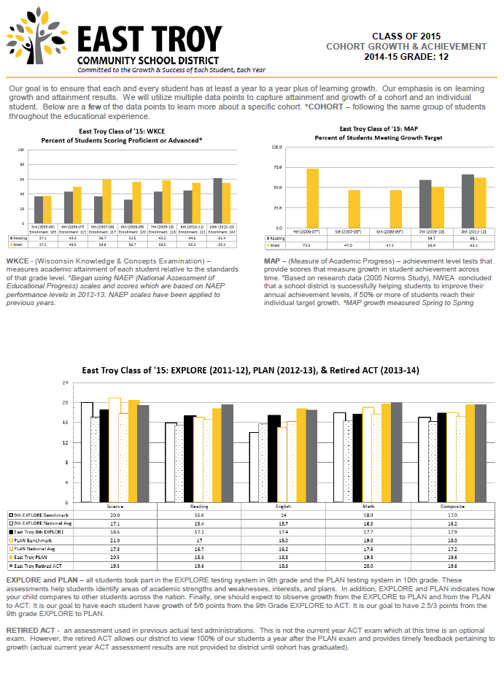
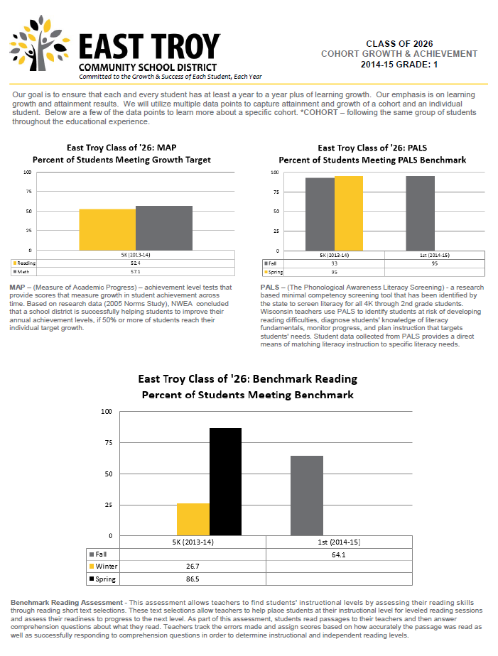
Student Achievement: Cohort Graphs
Cohort graphs are included in the Annual Meeting Appendix and on the District website

Slide 32
School Perceptions Survey
Grade 12 – Percent Strongly Agree and Agree
 | 2015 | 2014 | 2013 | 2012 | 2011 | 2010 | 2009
Do not feel part of the school | 19.67 | 26.05 | 19.7 | 25.37 | 25.00 | 18.26 | 17.07
Disruptive behavior in class | 36.06 | 43.60 | 28.90 | 44.02 | 24.07 | 26.96 | 22.76
No access to technology IN school | 5.73 | 11.75 | 17.70 | 30.59 | 21.29 | 7.82 | 4.87
Worry about my safety at school | 4.91 | 6.72 | 3.00 | 7.46 | 8.33 | 3.47 | 6.50
School does not offer courses I want | 45.08 | 41.17 | 39.35 | 44.02 | 50.92 | 32.86 | 37.39
Classes are irrelevant | 52.45 | 56.30 | 52.33 | 50.74 | 51.85 | 55.65 | 36.58
Poor study habits | 50.0 | 68.90 | 53.37 | 61.19 | 62.00 | 47.82 | 54.47
Classes poorly taught | 67.21 | 75.63 | 71.96 | 73.88 | 70.37 | 77.39 | 64.47
Teachers had high expectations of me | 81.13 | 79.82 | 89.00 | 80.58 | 78.7 | 88.69 | 87.80
School is boring | 66.66 | 70.58 | 57.93 | 58.94 | 71.29 | 66.94 | 63.40
I enjoy being at school | 55.82 | 45.37 | 51.39 | 58.94 | 51.84 | 51.29 | 60.97
Learning can be fun | 81.66 | 80.66 | 95.32 | 80.59 | 80.54 | 81.73 | 84.55

Slide 33
School Perceptions Survey
Grade 8 – Percent Strongly Agree and Agree
 | 2015 | 2014 | 2013
I feel safe at school | 86.25 | 80.69 | 88.59
Bullying was not a problem at school | 67.42 | 65.78 | 71.55
The school does a good job trying to prevent bullying from happening | 47.32 | 44.24 | 61.39
School does not offer courses I want | 38.28 | 51.37 | 33.02
My classes were interesting | 49.99 | 50.87 | 72.52
Poor study habits | 33.59 | 40.36 | 34.82
No access to technology in school | 28.45 | 33.92 | 19.64
Using technology made learning fun | 79.06 | 81.07 | 80.69
Using technology helped me learn | 70.53 | 79.27 | 76.06
My teacher allowed me to use technology on a daily basis to assist with my learning | 39.83 | 31.48 | 40.17
Classes poorly taught | 60.93 | 64.22 | 44.64
School is boring | 75.56 | 72.80 | 60.33
I enjoy being at school | 47.00 | 45.12 | 63.15
Learning can be fun | 61.06 | 60.51 | 81.03
I feel fully prepared for high school | 70.04 | 73.57 | 86.48

Slide 34
School Perceptions Survey
Grade 5 – Percent Strongly Agree and Agree
 | 2015 | 2014 | 2013
I feel safe at school | 92.1 | 91.60 | 87.26
Bullying was a problem at school | 26.11 | 22.89 | 37.26
The school does a good job trying to prevent bullying from happening | 76.57 | 68.74 | 74.76
School does not offer courses I want | 36.93 | 36.64 | 45.04
Poor study habits | 18.01 | 19.08 | 19.81
No access to technology in school | 12.71 | 24.02 | 28.03
Using technology made learning fun | 87.27 | 94.64 | 95.45
Using technology helped me learn more | 77.67 | 88.84 | 89.18
My teacher allowed me to use technology on a daily basis to assist with my learning | 79.43 | 62.49 | 61.68
Classes poorly taught | 11.71 | 23.66 | 12.62
School is boring | 20.90 | 51.5 | 47.7
I enjoy being at school | 78.94 | 53.02 | 58.92
Learning can be fun | 84.68 | 68.49 | 77.27
I feel fully prepared for middle school | 71.62 | 81.53 | 80.9

Slide 35
Youth Risk Behavior Survey
Percent of Students who have been harassed or bullied on school property during the last 12 months
 | 2015 | 2014 | 2013
I feel safe at school | 92.1 | 91.60 | 87.26
Bullying was a problem at school | 26.11 | 22.89 | 37.26
The school does a good job trying to prevent bullying from happening | 76.57 | 68.74 | 74.76
School does not offer courses I want | 36.93 | 36.64 | 45.04
Poor study habits | 18.01 | 19.08 | 19.81
No access to technology in school | 12.71 | 24.02 | 28.03
Using technology made learning fun | 87.27 | 94.64 | 95.45
Using technology helped me learn more | 77.67 | 88.84 | 89.18
My teacher allowed me to use technology on a daily basis to assist with my learning | 79.43 | 62.49 | 61.68
Classes poorly taught | 11.71 | 23.66 | 12.62
School is boring | 20.90 | 51.5 | 47.7
I enjoy being at school | 78.94 | 53.02 | 58.92
Learning can be fun | 84.68 | 68.49 | 77.27
I feel fully prepared for middle school | 71.62 | 81.53 | 80.9

Slide 36
Youth Risk Behavior Survey
Percent of Students who have been electronically bullied during the last 12 months
 | 2015 | 2014 | 2013
I feel safe at school | 92.1 | 91.60 | 87.26
Bullying was a problem at school | 26.11 | 22.89 | 37.26
The school does a good job trying to prevent bullying from happening | 76.57 | 68.74 | 74.76
School does not offer courses I want | 36.93 | 36.64 | 45.04
Poor study habits | 18.01 | 19.08 | 19.81
No access to technology in school | 12.71 | 24.02 | 28.03
Using technology made learning fun | 87.27 | 94.64 | 95.45
Using technology helped me learn more | 77.67 | 88.84 | 89.18
My teacher allowed me to use technology on a daily basis to assist with my learning | 79.43 | 62.49 | 61.68
Classes poorly taught | 11.71 | 23.66 | 12.62
School is boring | 20.90 | 51.5 | 47.7
I enjoy being at school | 78.94 | 53.02 | 58.92
Learning can be fun | 84.68 | 68.49 | 77.27
I feel fully prepared for middle school | 71.62 | 81.53 | 80.9

Slide 37
Youth Risk Behavior Survey
Percent of Students who agree that harassment and bullying is a problem at their school.
 | 2015 | 2014 | 2013
I feel safe at school | 92.1 | 91.60 | 87.26
Bullying was a problem at school | 26.11 | 22.89 | 37.26
The school does a good job trying to prevent bullying from happening | 76.57 | 68.74 | 74.76
School does not offer courses I want | 36.93 | 36.64 | 45.04
Poor study habits | 18.01 | 19.08 | 19.81
No access to technology in school | 12.71 | 24.02 | 28.03
Using technology made learning fun | 87.27 | 94.64 | 95.45
Using technology helped me learn more | 77.67 | 88.84 | 89.18
My teacher allowed me to use technology on a daily basis to assist with my learning | 79.43 | 62.49 | 61.68
Classes poorly taught | 11.71 | 23.66 | 12.62
School is boring | 20.90 | 51.5 | 47.7
I enjoy being at school | 78.94 | 53.02 | 58.92
Learning can be fun | 84.68 | 68.49 | 77.27
I feel fully prepared for middle school | 71.62 | 81.53 | 80.9

Slide 38
Additional Results
Additional District Data Points – attendance, truancy rate, drop out rate, suspensions, expulsions, retention rate, high school completion rates, open enrollment students, home-schooled students, ELL students, gifted and talented, special education, extra-curricular, etc
Additional Data Points are included in the Annual Meeting Appendix and on the District website
PBIS (Positive Behavioral Interventional Strategies)
YRBS (Youth Risk Behavior Survey)
School Perceptions Senior Survey

Slide 39
2014-15 TREASURER’S REPORT
Expenditures
Fund | Budgeted | Unaudited | Variance
General | 18,031,190 | 17,705,371 | (325,819)
Special Education | 2,101,350 | 1,944,410 | (156,940)
Debt Services | 1,878,376 | 1,875,902 | (2,474)
Revenues
Fund | Budgeted | Unaudited | Variance
General | 17,771,177 | 17,962,132 | 190,955
Special Education | 2,101,350 | 1,944,410 | (156,940)
Debt Services | 1,829,627 | 1,829,741 | 114
Total Fund Balance Increase of $256,761

Slide 40
2015-16 Key Aspects of REVENUES
State Budget:
February Proposal: Elimination of current $150 per pupil state aid and retain per pupil revenue limit from previous year ($0 increase)
Effect: Projected loss of $258,000 for 15-16 (-1.85% overall revenue decrease)
July 12th: Current $150 per pupil state aid returned
Effect: $0 / 0% revenue change from 14-15
Total Per Pupil Revenues: $16,883,421 (approximates the 2009 revenues)
State Aid July 1 Projection: $4,017,663*
Effect: Increase over 14-15 but still a decline from 05-06 ($~6.1 mil)
Local Taxes:
 | 2014-15 | 15-16 Projection | 14-15 to 15-16
Overall Levy | ~ $14.9 mil | $14,582,722 | - 2.14 %
Mill Rate | 10.42 | 10.20 | - 2.11 %
*A more conservative State Aid figure was used in the Budget Documents.

Slide 41
Relationship of State Aid and Local Taxes
Local Tax amounts (property taxes) are dependent on State Aid amounts
Key Aspects From Year to Year
State Aid increases and decreases
Local tax payers are likely to see an inverse increase/decrease of property taxes
School District Overall Revenues do not increase

Slide 42
2015-16 Key Aspects of SHORTFALL
 | Per Pupil Revenue Limit ($9,537.50) / Per Pupil State Aid ($150) (Change from previous year) | Projected Shortfall | Result
Pre-Feb | $0 / + $0 | $497,000 | -8% health insurance decrease ($388,000) Retirees coming off benefits ($110,000)
February | + $0 / - $150 | Additional $258,000 | Additional 12 items
July 12 | $0 / + $0 | $497,000 | $60,0000 returned to 15-16 budget in ongoing expenses $200,000 was used toward the 1:1 Tech Initiative
2016-17 | $0 / +$100 | $278,000 | $200,000 will be allocated to deficit

Slide 43
BUDGET HEARING
By S. 65.90 Wis. Stats, common school districts must hold the public budget hearing at the time and place of the annual meeting.
Residents have an opportunity to comment on the proposed budget.

Slide 44
School District Funds
# | Fund Name | Notes
10 | General | Used to record district financial activities for current operations, except those activities required to be accounted for in separate funds.
21 | Special Revenue Trust | Gift / Donations Fund – prudent when project directed by donation will cross fiscal years
27 | Special Education | Exceptional Educational Needs/Federal Handicapped/Other
30 | Debt Services | Irrepealable debt tax levy and related revenues. Principal, interest, and related long-term
38 | Non-referendum Approved Debt Service | Within the revenue limit
39 | Referendum Approved Debt Service | Voter approved, outside of the revenue limit
49 | Capital Projects Fund | Used for transactions financed with bonds, promissory notes issued per statute.

Slide 45
School District Funds
# | Fund Name | Notes
50 | Food Service | Federal regulations require separate accounting for Food Service. Fund deficit must be eliminated through transfer from the General Fund. Fund balance must be retained for use in Food Service.
70 | Trust | These funds are used to account for assets held by the district in a trustee capacity for individuals, private organizations, or other governments. East Troy utilizes this fund for its scholarship donations.
80 | Community Service | Fund established through S. 120.13 and 120.61, Wis. Stats. Allows a school board to permit use of district property for civic purposes. Examples of activities could include adult education, community recreation programs, and/or day care services. Act 20 created new requirements for this Fund for the 2013-14 school year, however starting with the 15-16 school year, the levy freeze and reporting requirements have been discontinued.

Slide 46
Long Term Debt
As of June 1, 2015
Remaining principal on Fund 38
$428,486
Debt Expires 9/19/2018
Remaining principal on Fund 39
$1,215,000
Debt Expires 3/1/2018
New principal on Fund 39 (As of Sept. 1, 2015)
$18,600,000
Dept Expires 3/1/2035

Slide 47
Resolutions
(Sample Resolutions on last page of Annual Booklet)
Resolution A: Adoption of Tax Levy
Resolution B: Salaries for Board of Education Members
Resolution C: Set Date and Time for 2016 Annual Meeting
Resolution D: Acquisition of Real Property
Resolution E: Leasing of Property

Slide 48
XIII. NEW BUSINESS
XIV. ADJOURN

